Slide 1
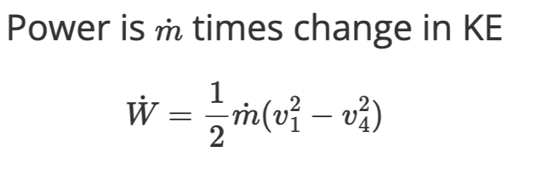
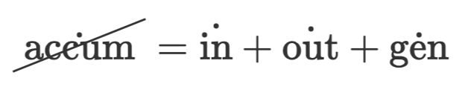
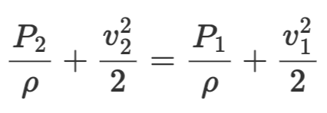
P₂
P₃
v₁
1
2
3
4
v₄
Mass
at the rotor
F
Momentum
Energy
Similar for other points, 3, 4, etc.

