Slide 1
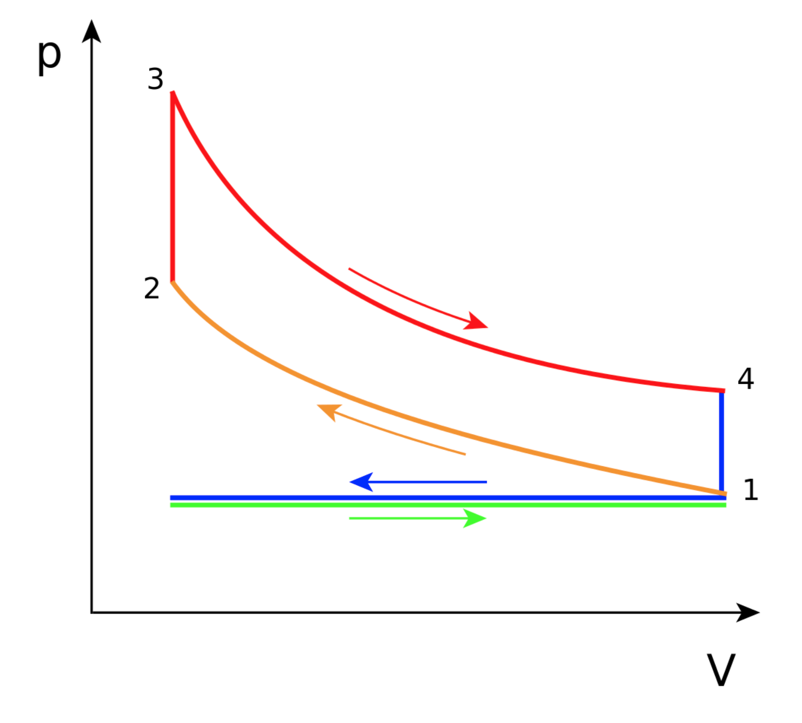
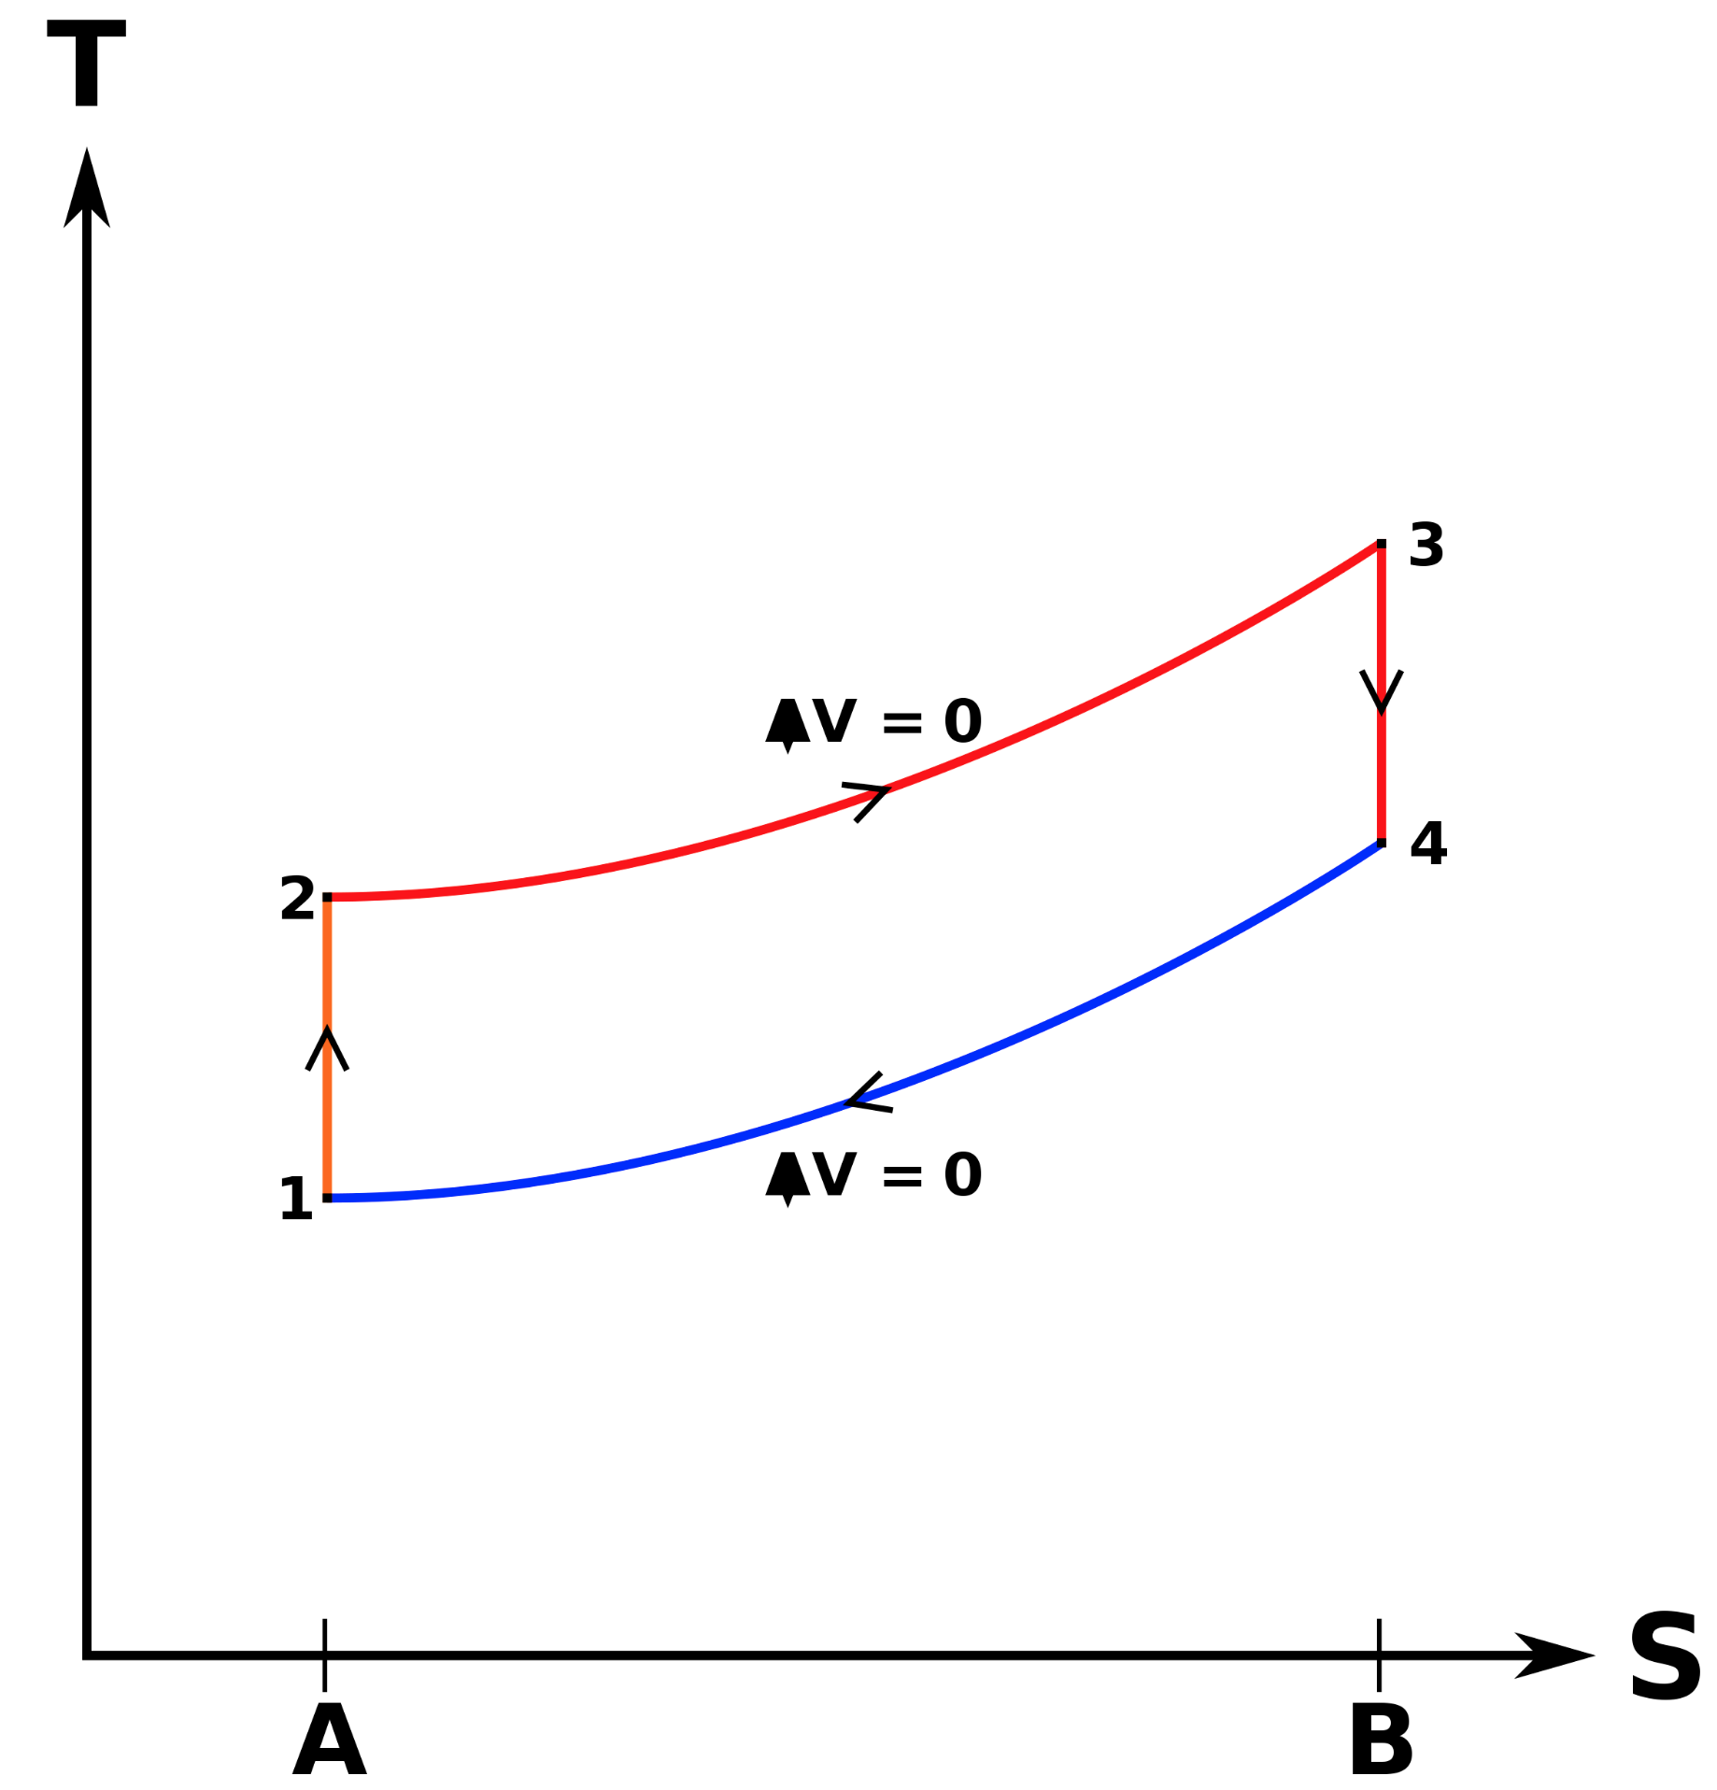
T
Q_{in}: combustion
W_{out}: expansion
Q_{in}: combustion
W_{out}: expansion
W_{in}: compression
W_{in}: compression
Q_{out}: valve open
Exhaust
Q: valve open
Q_{out}: valve open
0
Intake
S

