Slide 1
Resumes
How to prepare your resume to maximize your chances of getting an interview for the job you seek

Slide 2
Rules of Thumb
70% of all jobs are by referral
All jobs require a resume

Slide 3
Key Concepts
First impression/layout
Error-free
Easy to read
Layout directs reader to key features
One page
White (or off-white) paper
Scannable version

Slide 4
Essential Components
Personal Information (contact)
Objective (optional)
Education
Related Experience
Activities/Honors
References available upon request (optional)

Slide 5
Personal Information
Name
Large, Bold, (All caps, or not)
Address
Campus, permanent
Phone
Email
Do not give
Age
Health
Marital / Family status
Other personal information irrelevant to job.
(Some info is illegal for recruiters to ask for…)

Slide 6
Objective
Optional
Be specific
Provide some useful information
But not so specific that you eliminate opportunities
If possible, customize for specific job announcement
Examples
“A summer internship” (general, duh)
“A summer internship in the environmental field” (better)
“A challenging position with a progressive company” (vague, generic)

Slide 7
Education
Most recent school first
Full university name and location
Degree you will receive and major
Graduation date
GPA
If you leave it off, it will be assumed low
Example
B.S., Chemical Engineering, Brigham Young University, Provo, Utah, GPA: 3.6/4.0, Expected graduation April 2015

Slide 8
Education
Pertinent and unique courses/skills
Don’t need to list core courses, you’re a chemical engineer.
This can be good for an internship, though, since it indicates your level of education.
Especially: Core like Fluid Mechanics, Heat Transfer, etc.
Elective courses that highlight specific skills, especially as relate to the job.
Semiconductor course
Combustion course
Computer programming courses

Slide 9
Experience
Most recent first
“All” jobs should be listed
List organization, location, your title, dates
Bullet your key accomplishments
This is where you shine!

Slide 10
Key Accomplishments (Dow)
Three questions:
What did I do?
What did I change or impact?
What was the value of that change or impact?
(many students just list responsibilities…)

Slide 11
Example 1
What did I do?
Responsible for improving reactor performance.
What did I change or impact?
Improved batch reactor turnaround time by 3%
What was the value of that change or impact?
Created $250,000 annual savings by improving reactor turnaround time by 3%

Slide 12
Activities and Honors
Activities
College organizations
Extracurricular (sports, music, drama, etc.)
Honor societies
Professional organizations (AIChE)
List leadership positions or committee work
Title and Role
Honors
Scholarships
Awards
Keep it relevant, show your soft-skills and leadership skills.
“Hiking and Biking?”

Slide 13
Missions/Church Service
Not required
But missing 2 years or 18 months may be questioned.
Can include as a work experience or activity
Use to demonstrate skills/traits
Leadership, service, interpersonal skills.
Avoid jargon that will not be understood
“Ward”, “Elders Quorum”
Focus on relevant skills developed vs. the spiritual nature of the work.

Slide 14
Missions/Church Service
Example
Voluntary Representative, The Church of Jesus Christ of Latter-day Saints, Nagoya, Japan, 1997-1999
Conducted presentations for individuals and groups
Performed community service activities
Supervised 10 other volunteers as Zone Leader
Learned to speak, read, and write Japanese
President of Women’s Service Organization…
Coordinated service activities of 60 volunteers

Slide 15
Additional Categories
Interests
Hobbies
Skills
References (optional)
Keep it relevant.

Slide 16
Questions to Answer
What are my strengths, acquired skills, and talents?
When someone else reads my resume, do they recognize them?
Where is this resume going?
What is my goal?
How will my resume be read and interpreted?
All resumes say something about their creators…What does yours say?
From Brett Pennington, recruiter from ExxonMobil

Slide 17
Conclusions
A good resume takes time
Let others read and critique your resume
Keep it up to date and on hand
Three keys
Well organized and Pretty (well, not that pretty)
Format, no data dump, spelling, white space
Accurate
Meaningful, but brief

Slide 18
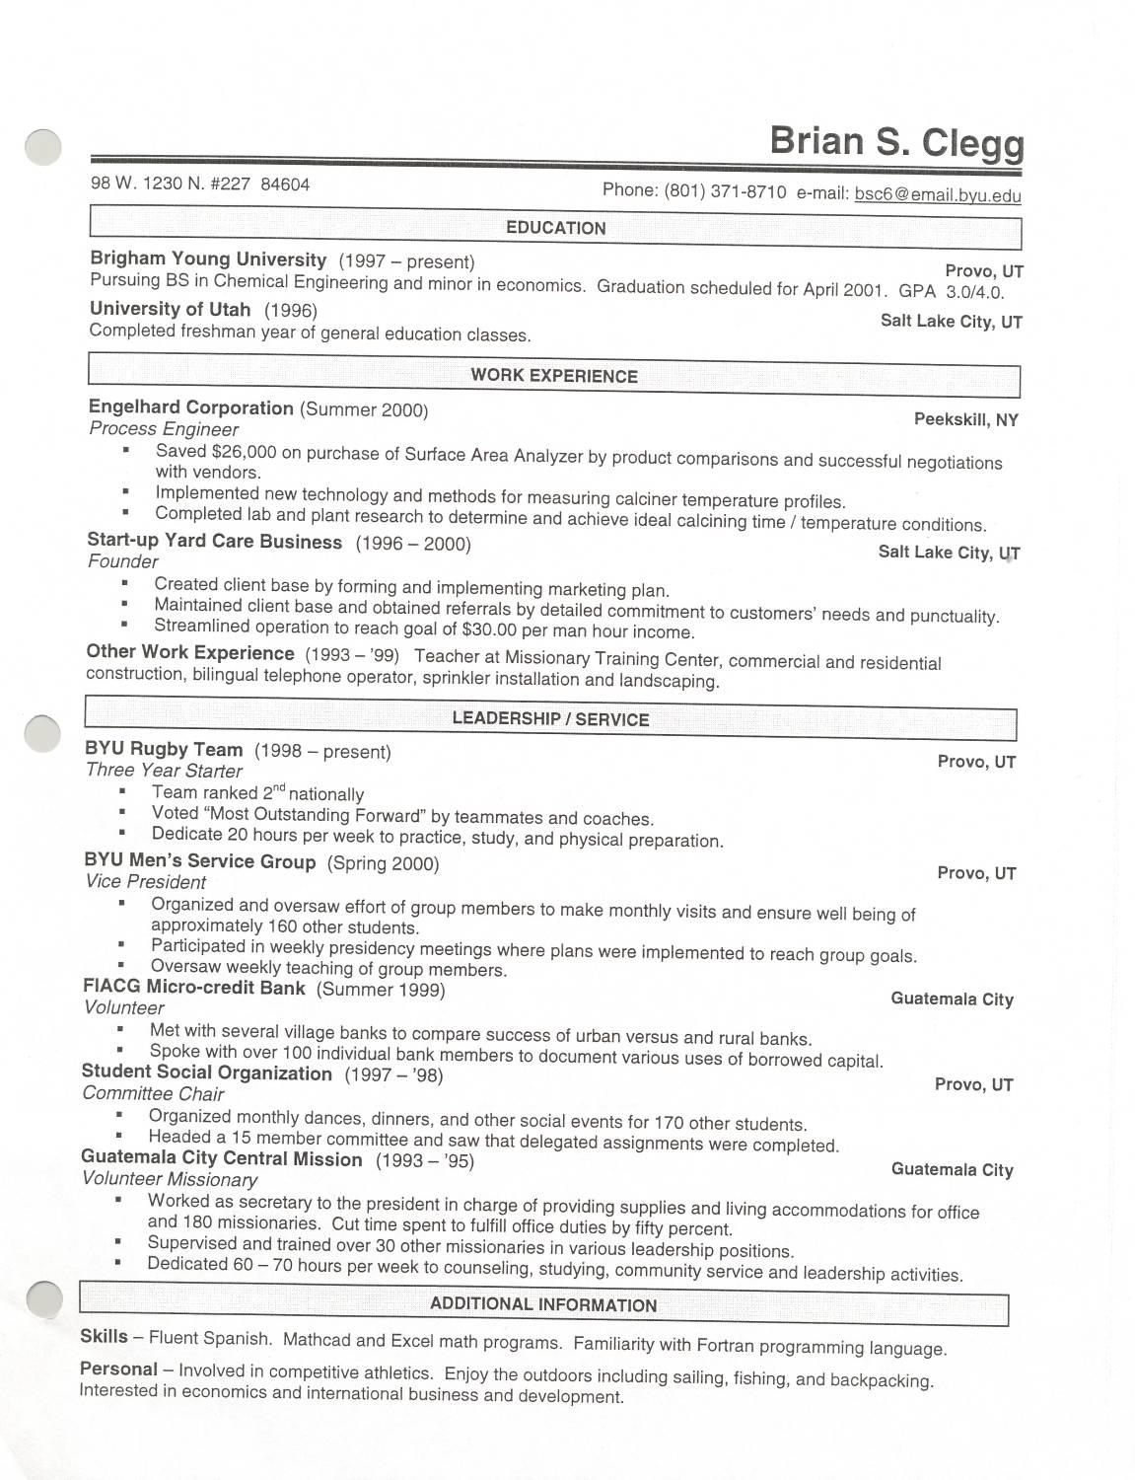
Recruiter comment:
I loved the content of the bullets, but the format was not attractive

Slide 19
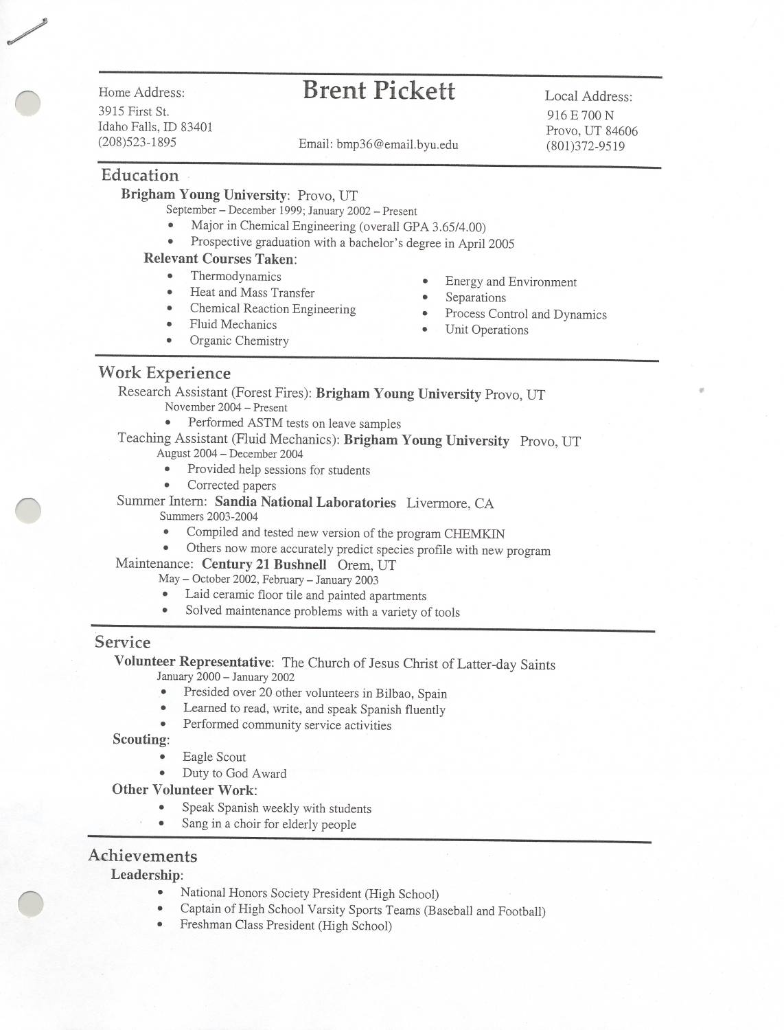
Observation:
Format very attractive, but bullet items not very descriptive of contribution

Slide 20
Assignment
Use these guidelines to make or update your personal resume
Bring two copies to class
We will have you review resumes from 2 other students
I will then review the modified resumes

